Slide 1
Abusing Active
Directory Certificate Services (AD CS)
Lesson 17.2
Cybersecurity
Lesson 16.4

Slide 2
Class Objectives
By the end of today’s class, you will be able to:
Understand the role of Active Directory Certificate Services
in a Windows Domain.
Identify common misconfigurations in AD CS that can be exploited.
Perform attacks to abuse AD CS, including certificate request forgery
and exploitation of misconfigured templates.
Understand how these techniques can be used for privilege escalation and lateral movement in a domain environment.

Slide 3

Overview of
AD Certificate Services

Slide 4
Active Directory Certificate Services (AD CS) is a crucial component within a Windows domain that provides public key infrastructure (PKI) services. It enables the creation, management, and distribution of digital certificates, which are used to secure communications; authenticate users, devices, and services; and ensure the integrity of data.

Slide 5
Role of AD CS in a Windows Domain
Issue certificates for various purposes (i.e. encrypting email, SSL or TLS, authentication)
Authenticate users or machines within a domain (smart cards or MFA)
Secure communications through established channels, including https, S/MIME, and VPNs
Enable encryption and digital signatures

Slide 6
Enterprise Environments
Common setups and configurations
Enterprise Root and Subordinate CA to issue secure certificates.
Certificate Templates to standardize properties and policies of certificates.
Autoenrollment to automate enrollment of users and devices without manual intervention.
Network Device Enrollment Service (NDES) to secure non-Windows devices.
Online Responder to provide real-time certificate status-checking.

Slide 7

AD CS in Enterprise Security
Provides a foundation for trust within the domain by assuring that
only authorized users and devices can access sensitive resources.

Slide 8
AD CS Misconfigurations
Improperly configured Certificate Services can lead to significant vulnerabilities
Forged Certificates
User Impersonation
Escalated Privileges

Slide 10
Identifying misconfigurations
In this activity, you will explore a pre-configured AD CS environment to identify potential misconfigurations.
15 minutes

Slide 13

Certificate Request Forgery

Slide 14
Certificate Forgery
Misconfigurations that are typically exploited include:
Overly permissive enrollment permissions
User-controlled subject names
Weak cryptographic settings

Slide 15



Tools to Exploit AD CS
Certify
Rubeus
A tool from GhostPack that allows for enumeration of certificate templates, finding vulnerabilities, and crafting certificate requests.
A post-exploitation tool that allows for manipulating Kerberos tickets

Slide 16
Certificate request forgery activity

Slide 17
Summary
Critical Analysis of Misconfigurations
Small misconfigurations lead to significant risk of breach.
Defense in Depth
Protecting CS is one part of the story; layered security measures will mitigate damages.
Real-World Implications
Consider advanced persistent threats and how these techniques are used in everyday life.

Slide 19
Exploiting vulnerable templates
In this activity, you will exploit the vulnerabilities you learned
about earlier by performing a certificate request forgery against vulnerable templates.
20 minutes

Slide 22

To finish class, we’ll review what we’ve learned about pen testing with a game of

Slide 23
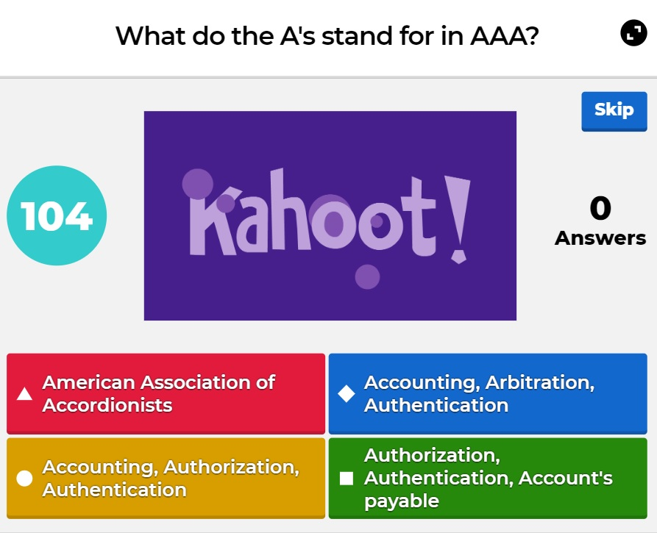

What’s Kahoot?
Kahoot! is a web-based tool that:
Displays questions and answers to select from
in real time.
Keeps track of individual and team scores.
Keeps track of remaining time for each question.

Slide 24


Rules and Guidelines
There are a total of 30 questions.
Points are not deducted for
incorrect answers.
You will have two minutes to answer each question.
If you are competing as a team,
select a team captain to answer
the questions.
Points are awarded for correct answers and for how quickly you answer compared to your classmates.
Note: If your class is currently online,
it will be easier if each student competes individually.

Slide 25
Start the Kahoot! Pen Testing Week 2 Challenge by accessing the link:
Kahoot! Pen Testing Week 2 Challenge

Slide 26
Setup
01
Select Play if you are logged in. Select Play as Guest if you do not have
a Kahoot! account.
02
Select Classic if you are competing individually and Team Mode if you are competing in a group.
03
Leave all the other options as default.
04
Follow the instructions on the screen by going to kahoot.it.
05
Enter the unique Kahoot! code.
06
Select Start to begin.

